Slide 1


Mass Detection Using Deep Convolutional Neural Network with Java
Basel Alyafi, Zafar Toshpulatov, Fahad Khalid

Slide 2
Overview
Introduction
Problem description
Background
LeNet
AlexNet
Transfer Learning
Data Acquisition
Proposed methodology
Results
Conclusion
Environment

Slide 3
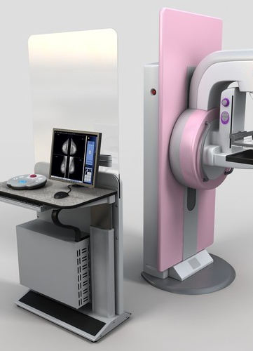
Introduction
In 2018, 266,120 new cases of women invasive breast cancer.
Breast cancer: leading tumor in Italy
One every six deaths from cancer in women

Slide 4
CAD Systems
Computer Aided Diagnosis (CAD) systems.
improve detection accuracy, assist specialists.
Increases radiologists sensitivity (62% to 85% for juniors, 77% to 85% for experts)

Slide 5
Problem description
410 digital mammograms were taken from INbreast data set (107 with masses, 303 without masses).
Using that data set, train a Neural Network to classify unseen mammograms.

Slide 6
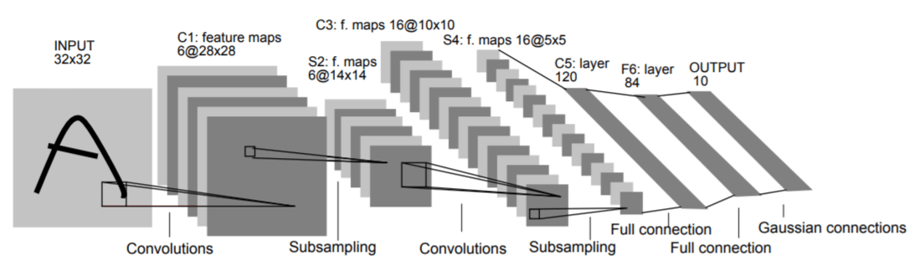
LeNet
First architecture for Convolutional Neural Networks, LeCun 1998.
Straightforward and small
It can even run on the CPU
It consists of two sets of convolutional, activation, and pooling layers, followed by a fully-connected layer, activation and softmax classifier

Slide 7
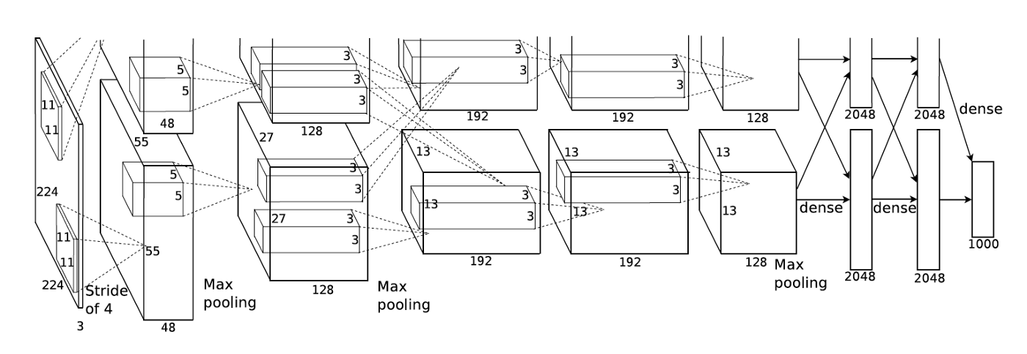
AlexNet
Deep Convolutional Neural Network for image classification.
It won the ILSVRC-2012 competition, top-5 test error rate of 15.3%.
8 layers, 5 convolutional and the last 3 are fully connected.

Slide 8
Transfer Learning
To store knowledge and apply it on a different problem.
Transfer learned capabilities from general task to a specific one.
Network pre-trained on ImageNet dataset, (1.2 million images, 1,000 classes) .
Last fully-connected layer is replaced by a new layer for classification of 2 classes: mass and normal.
The modified DCNN is subsequently retuned for mammographic dataset.

Slide 9
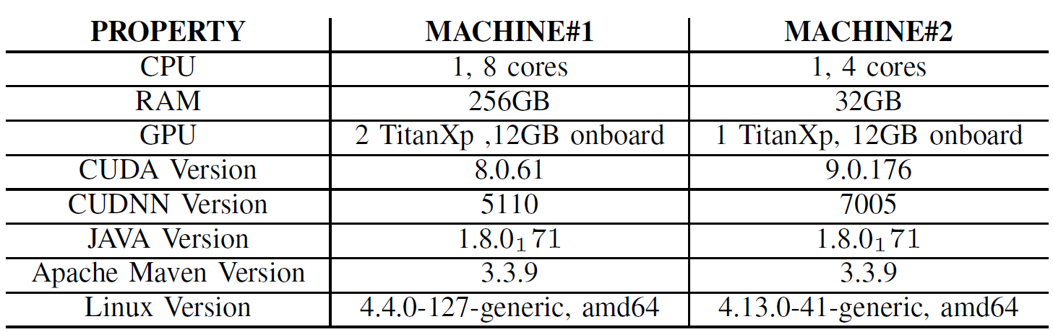
Environment

Slide 10
Data Acquisition
Publicly available INbreast data containing 410 mammogram images
Generate 3 different-size data sets.
Open-CV C++ was used, why? Fast and powerful
Small
2000 images
Medium
6000 images
Large
20000 images
Test set
30 %
Train set 70 %
Test set
30 %
Train set 70 %
Test set
30 %
Train set 70 %
Pos.
Neg.
Pos.
Neg.
Pos.
Neg.
Pos.
Neg.
Pos.
Neg.
Pos.
Neg.

Slide 11
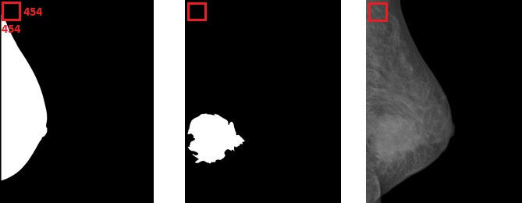
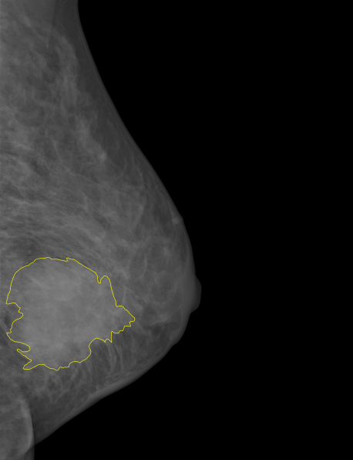
Data Acquisition
Windowing method, size 454 x 454 pixels.
moving the window from left to right and top to bottom
Different strides for massy and normal images.
Mask
Ground truth
Mammogram
Overlay

Slide 12
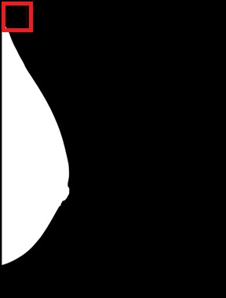
Data Acquisition
Start from the 10 x 10 pixel, due to 10 pixels black tiling.
A chance of skipping the complete breast if breast size is small, otherwise.

Slide 13
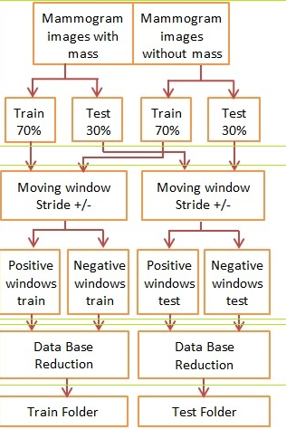
Data Acquisition
The description of the method step by step:
Split images into massy and normal mammograms. merge classes to form on train set and one test set.
Moving window and positive, negative windows generation
Reduce positive and negative windows

Slide 14
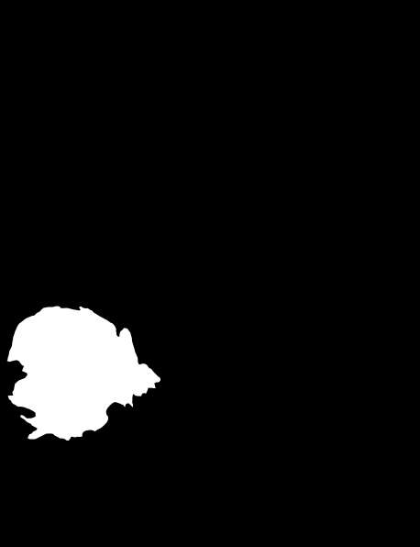
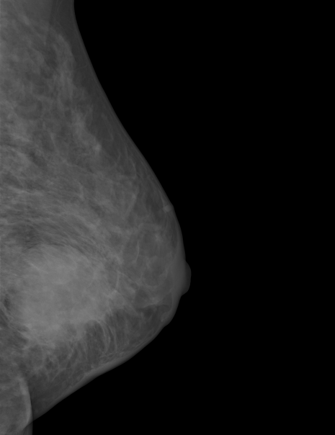

Data Acquisition
A. Split images into massy and normal mammograms
Ground truth
Mammogram
Mask
Mammogram
Mass
No mass
Test
30 %
Train
70 %
Test
30 %
Train
70 %

Slide 15


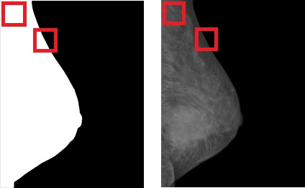
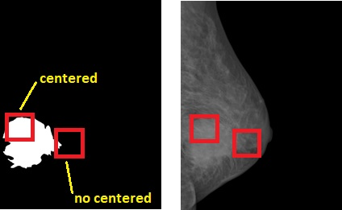
Data Acquisition
B. Moving window and positive, negative windows generation
The breast area is considered only.
Centered masses are saved as positive windows.
Normal tissues are saved as negative.
Mask
Mammogram
Ground truth
Mammogram

Slide 16
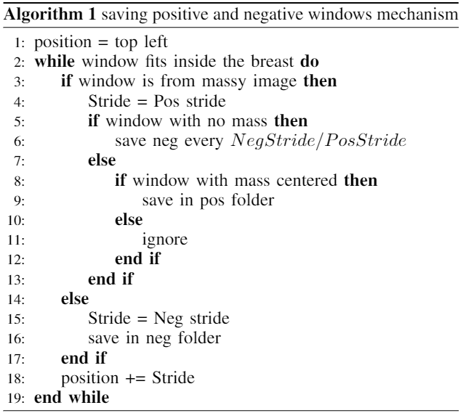
Moving window

Slide 17
Data Acquisition
C. Reduce positive and negative windows
-To resize output dataset
-Regular pattern of selecting windows.
-Avoid random selection to never skip images.

Slide 18

Proposed methodology
The Deep Learning for Java examples that were used are:
Convolution
Mammogramm Classificaton using LeNet.
Transfer Learning
EditLastLayerOthersFrozen + validation step + accept argument list (epochs number, train folder, test folder, model path).
EditAtBottleneckOthersFrozen + validation + accept arguments list to reduce needed building times.

Slide 19

Proposed methodology hyperparameters
Epochs number
Metric Accuracy metric is considered only due to balanced classes).
Batch size according to size of the data set
Validation portion and train test portion 80% and 20% respectively, except for Bottleneck, 10% to reduce the processing burden.
Feature extraction layer: (fc2) for lastlayer, block 5 pool for bottleneck.
Activation function: LEAKYRELU and TANH.

Slide 20
Result: LeNet Classification
Best accuracy: Large 82.81%.

Slide 21
Result: Edit Bottle Neck Others Frozen
Best accuracy: Small 55.49%.

Slide 22
Result: Edit Last Layer Others Frozen
Best accuracy: Large 91.96%.

Slide 23

Conclusion and Future work
Edit last layer others frozen, most promising.
Size of data set has an effect.
Parameter tuning by grid search
cross validation.

Slide 24

شكراً لكم

